Slide 1
JOUR 352: Interactive Design and
Development
Brittany Renee Mayes
brmayes@umd.edu

Slide 2
Agenda
Welcome
Introduction to your professor and classmates
Syllabus review
Resource sign up
Where this class could take you
Lecture: HTML basics

Slide 3
Course Overview
In this course, students will use web design and development for visual storytelling. From graphic design fundamentals to basic data analysis and visualization, students will use the tools of the web for digital news production. By the end of the semester, students will build a digital resume/portfolio package and create a multimedia news
feature story.
The core of the class will be learning HTML, CSS and JavaScript to produce work for desktop and mobile experiences. The course will also discuss photo editing, search engine optimization, web analytics and ethics. The class will include lectures, but will largely be hands-on in-class assignments and online, self-directed learning modules.

Slide 4

Who am I?
Currently: Graphics reporter for The Washington Post
Previously: News Apps Developer at NPR; Visuals Intern at NPR
Graduated from UNC-Chapel Hill journalism school in 2016
Attended the New York Times Student Journalism Institute

Slide 5
On any given day, I...
Research and report out stories, from breaking news to features
Write HTML, CSS, javascript or python
Analyze data
Make “daily” graphics
Prep print graphics for the next day’s paper

Slide 6
Introductions
Name
Class
Journalism experience
Technology, design and software skills
Why you’re here
Hopeful takeaways

Slide 7
Syllabus Review

Slide 8
Sign up for online class resources
Github - For version control of your code, site hosting
Codecademy - Used to learn coding basics, will be frequented for homework assignments
LinkedIn Learning - Formerly Lynda.com, online video tutorials for design and code
Download:
Atom - Open source editing software

Slide 9

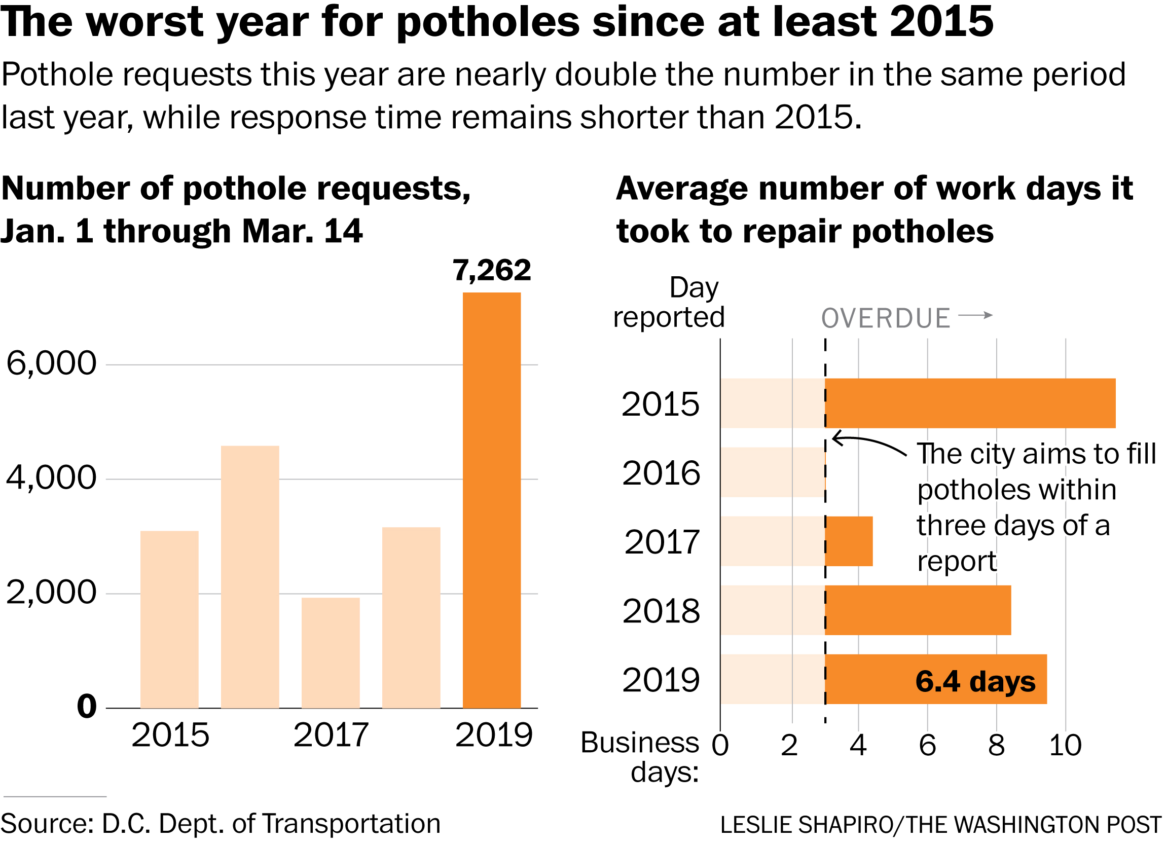
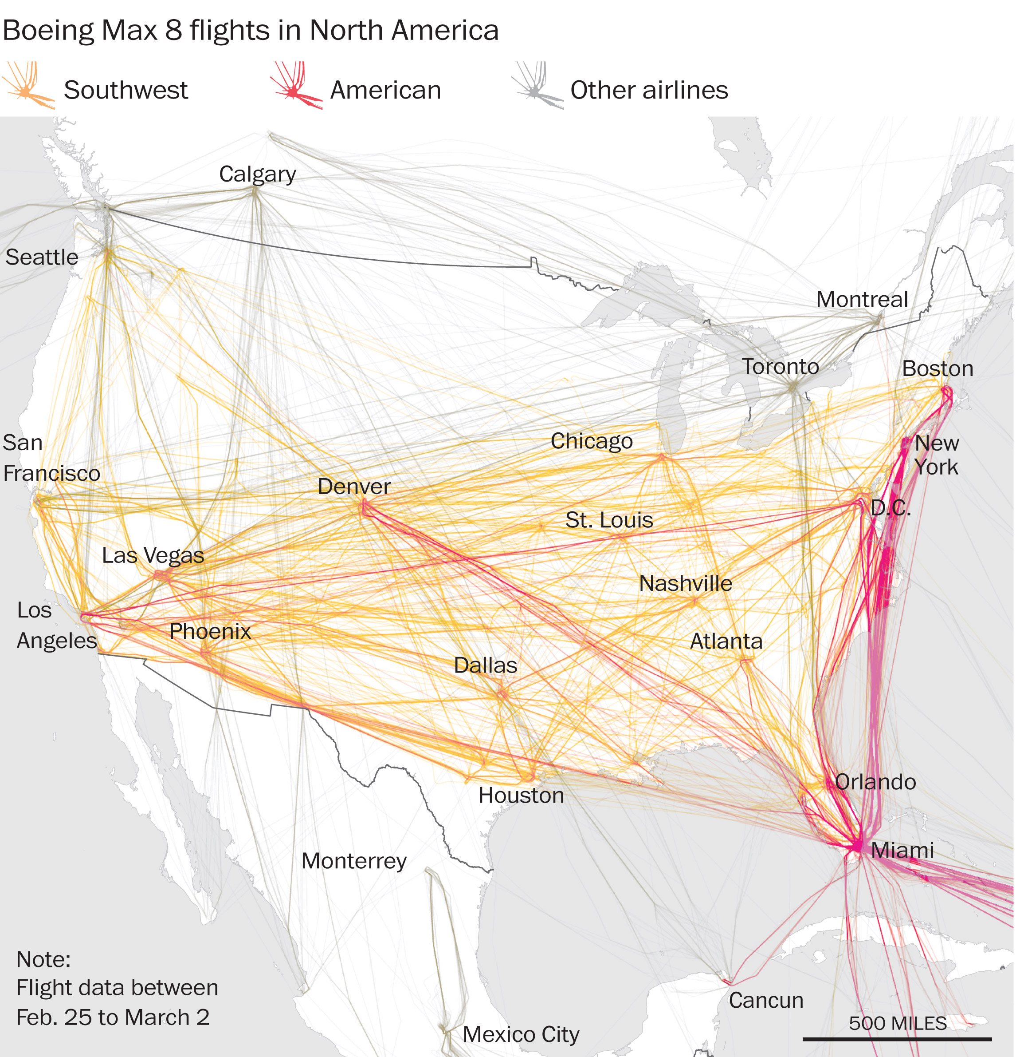
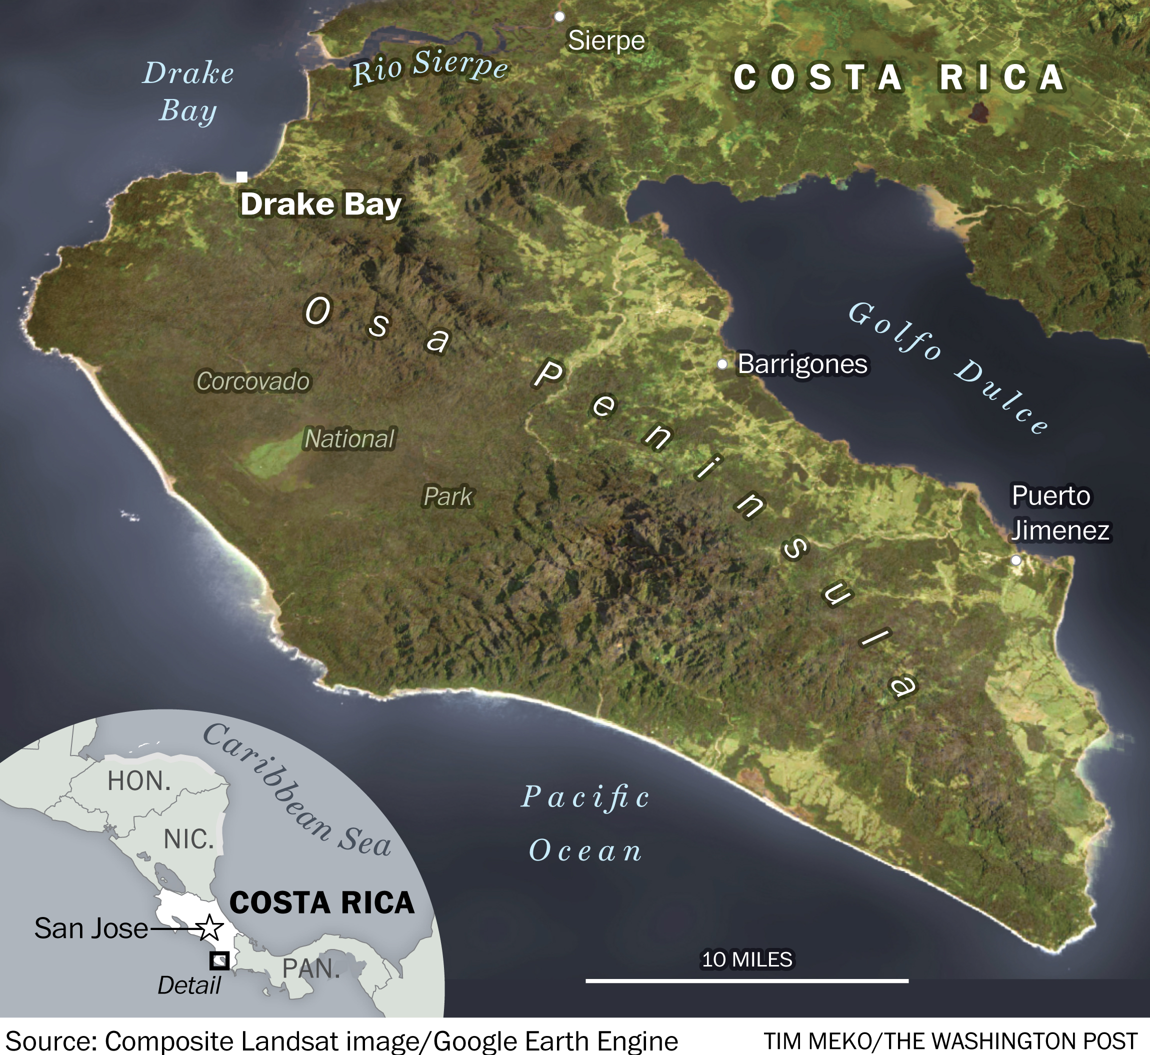
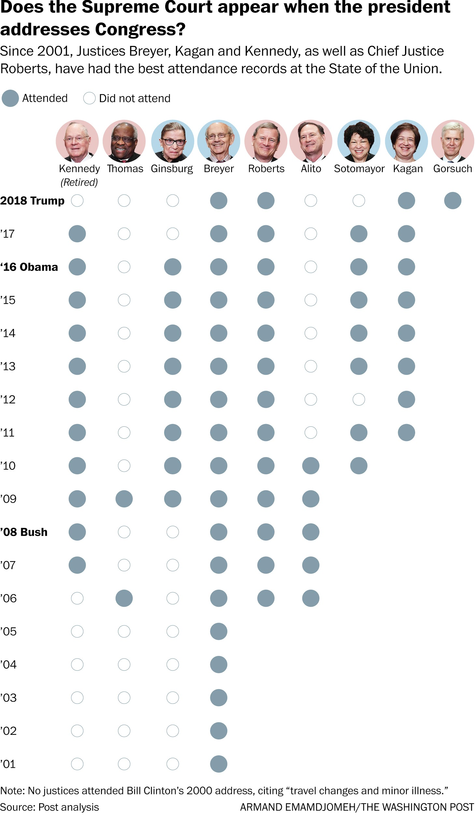
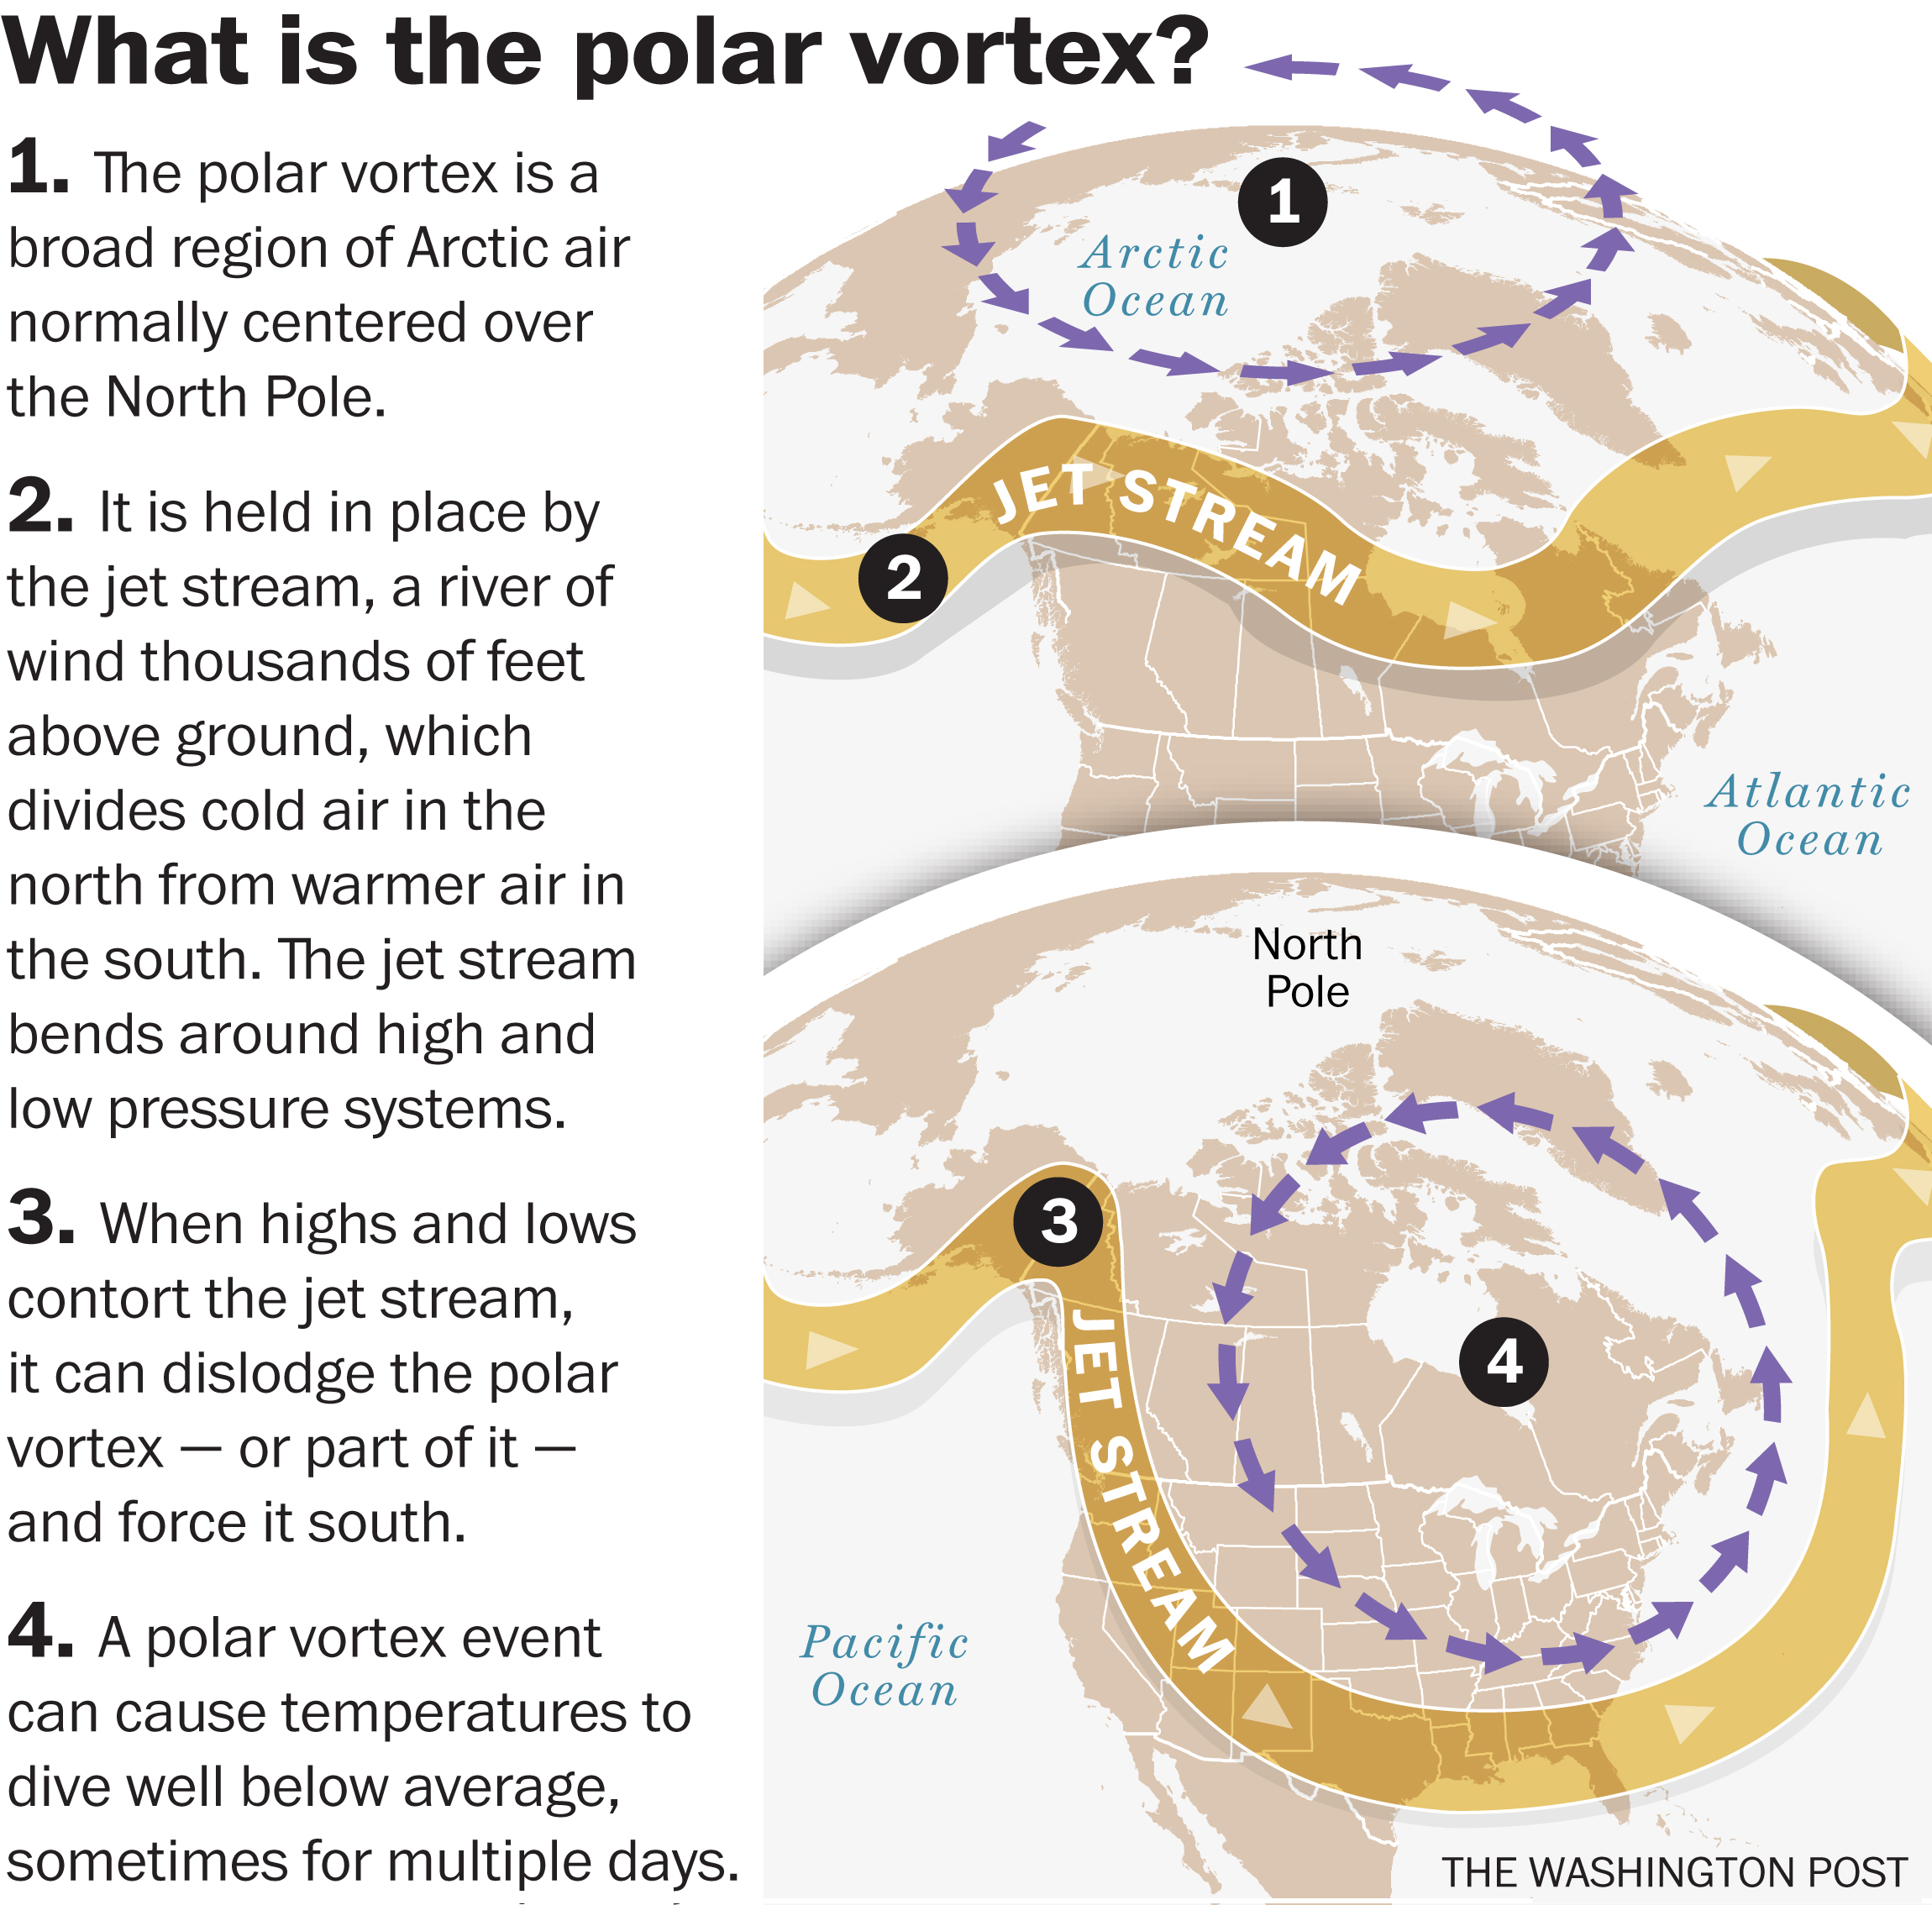
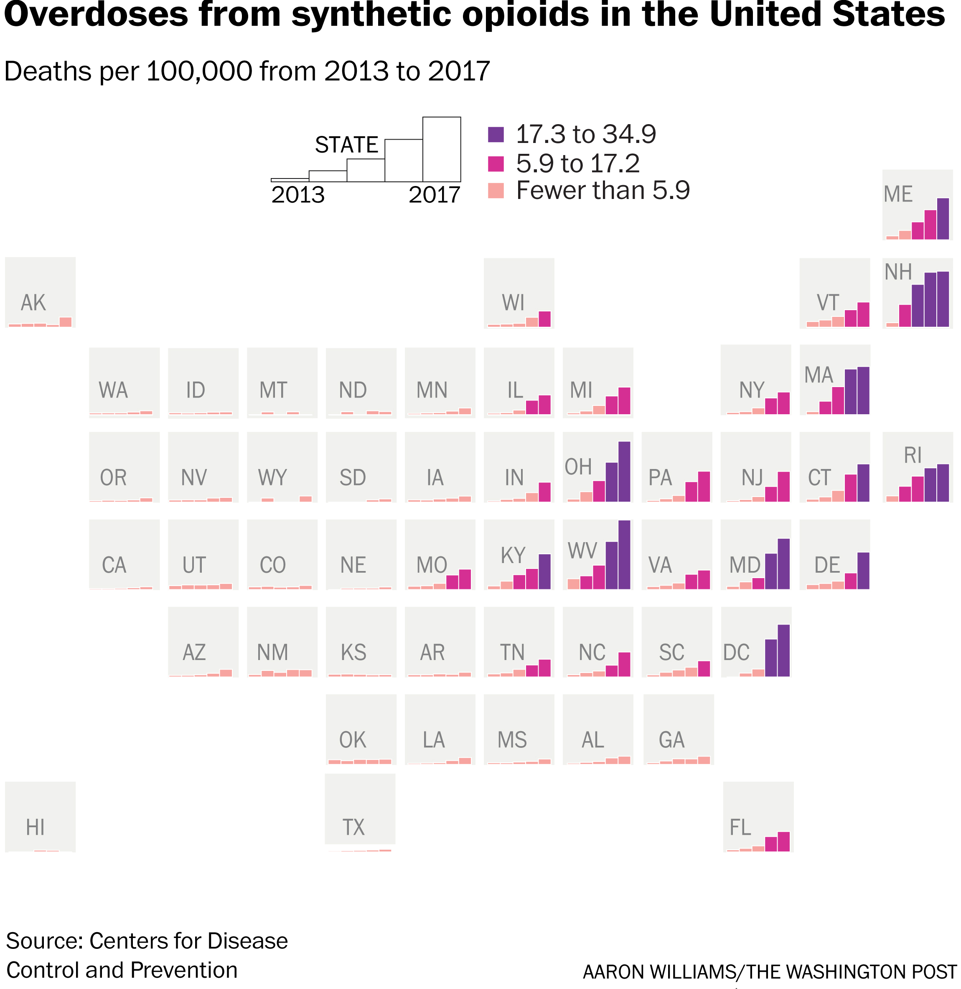
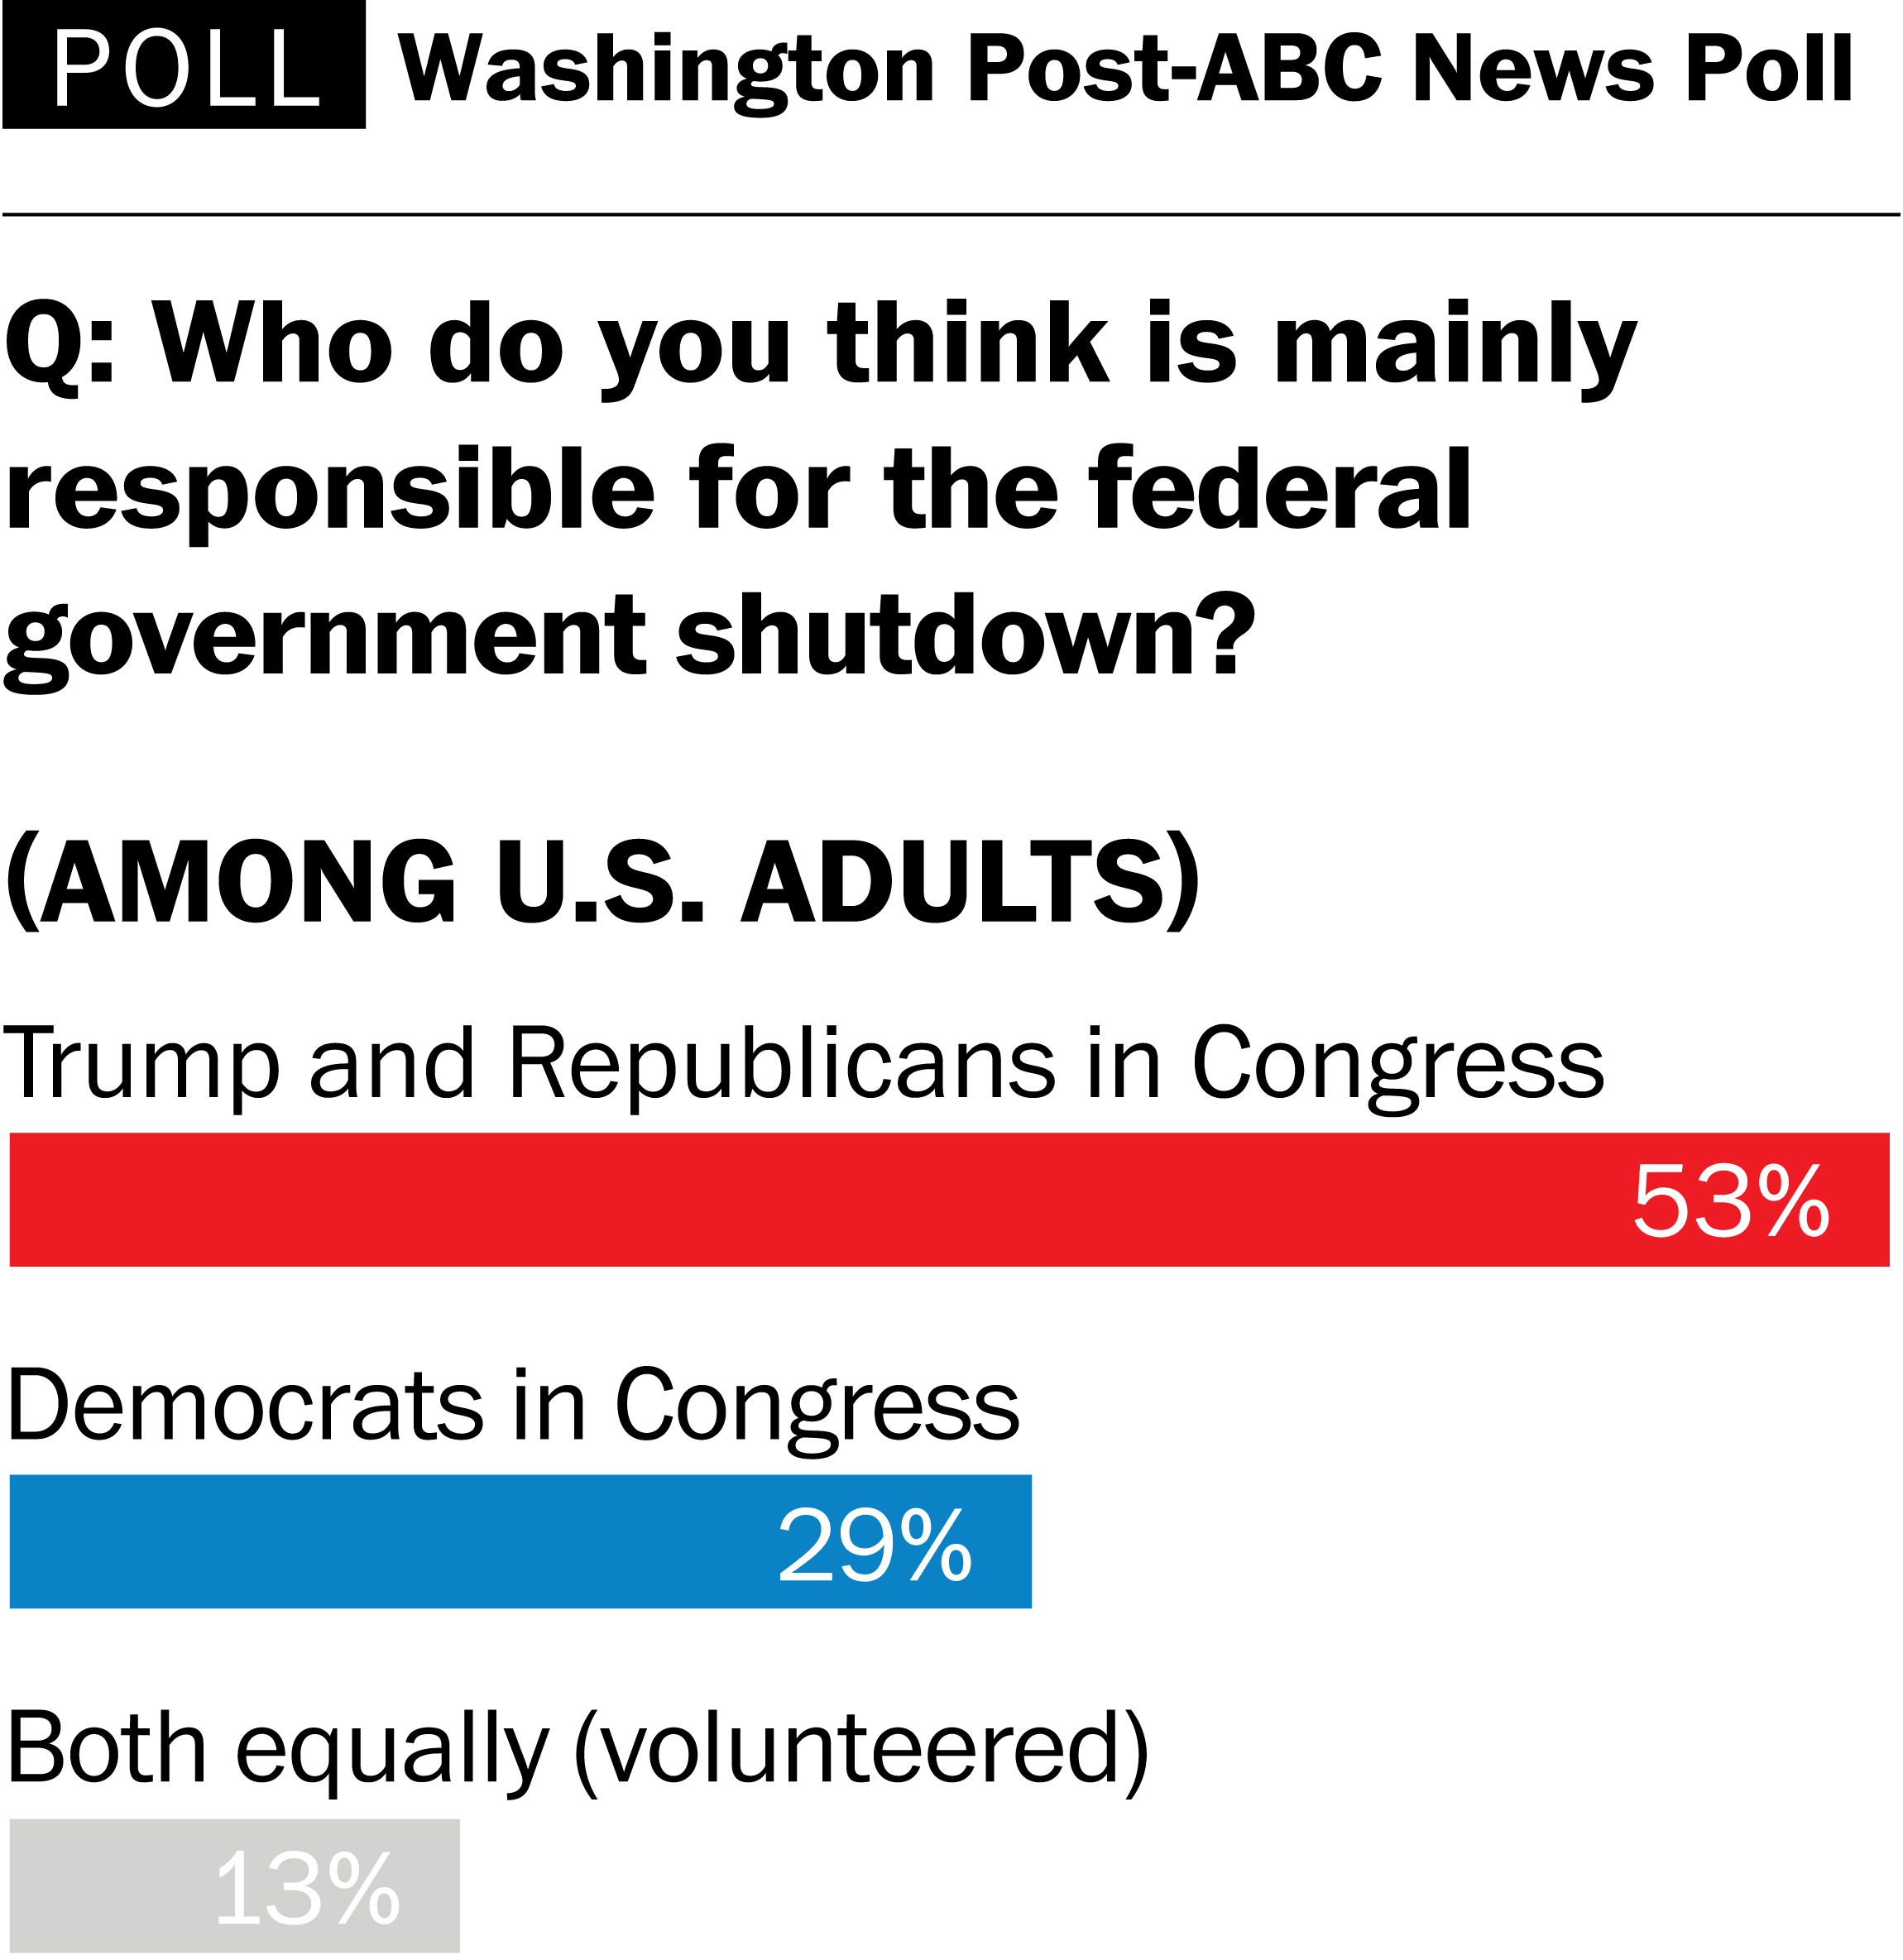

Slide 10

Who is @PostGraphics and what is a graphics reporter? We’re reporters but we’re also…
Illustrators
Cartographers
Data analysts
Back-end engineers
Front-end developers
Designers
Editors

Slide 11
What tools do we use?
HTML, CSS
Javascript
jQuery
Node.js
Python
Jupyter Notebook
SQL
Illustrator
Photoshop
After Effects
Methode (CMS)
Ellipsis (CMS)
Anglerfish (CMS)
Blender
QGIS
And more...

Slide 12
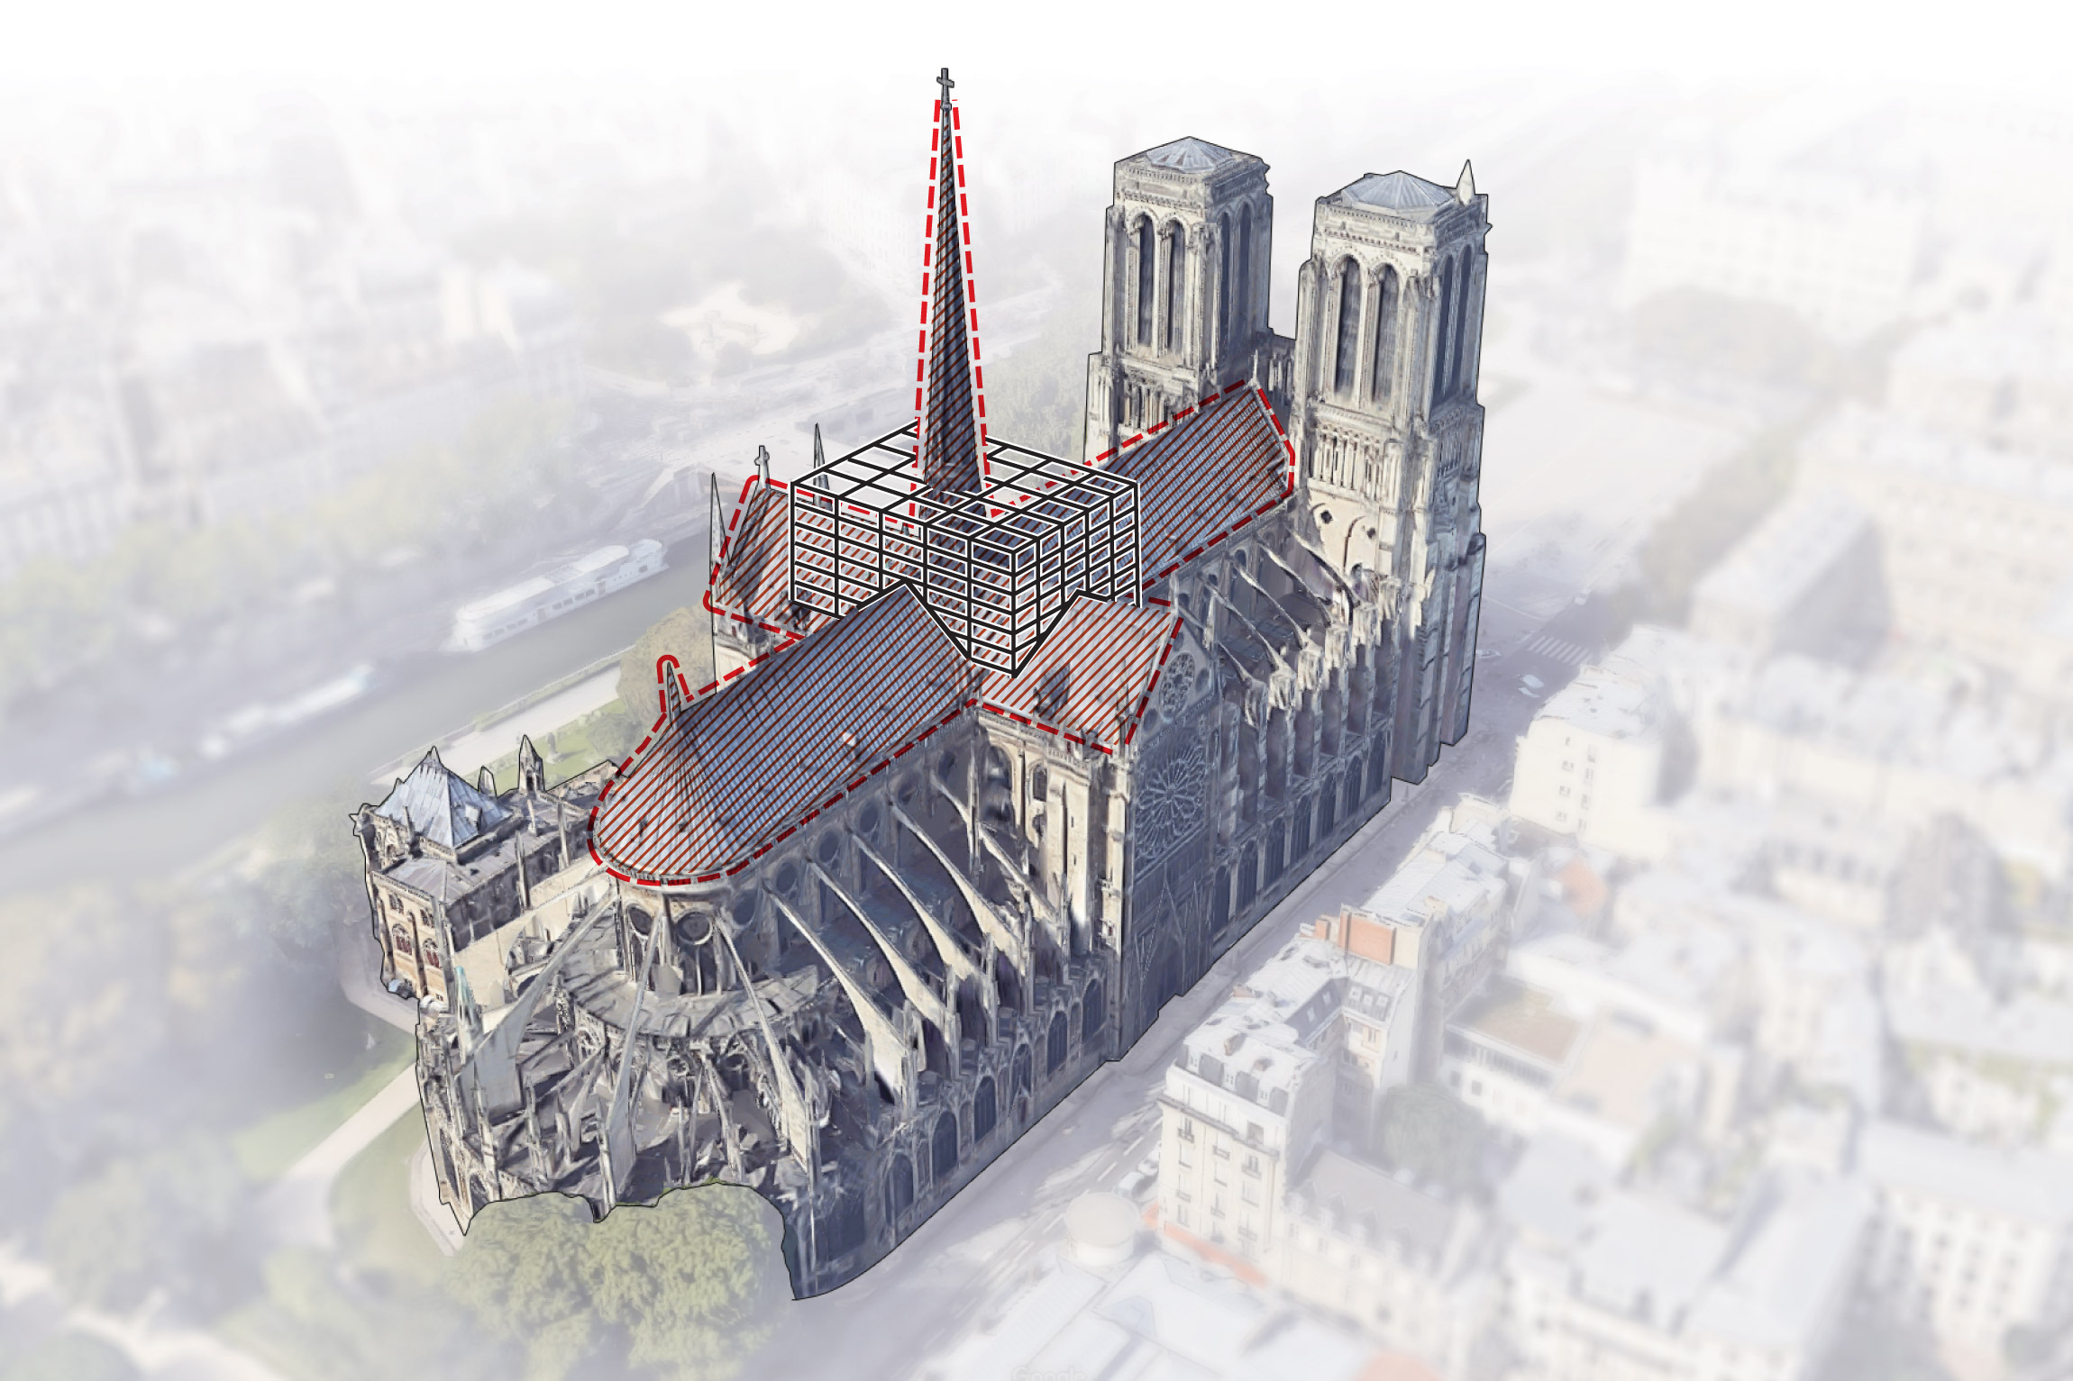
We make graphics on:
Breaking news
Rebuilding Notre Dame: The next steps for Paris’s famous cathedral
https://wapo.st/rebuilding-nd

Slide 13
We’ve also made graphics on:
Game of Thrones
An illustrated guide to all 2,339 deaths in ‘Game of Thrones’
http://wapo.st/thrones

Slide 14
We’ve also made graphics on:
Public lands
What remains of Bears Ears
http://wapo.st/bears-ears
Podcast clip

Slide 15
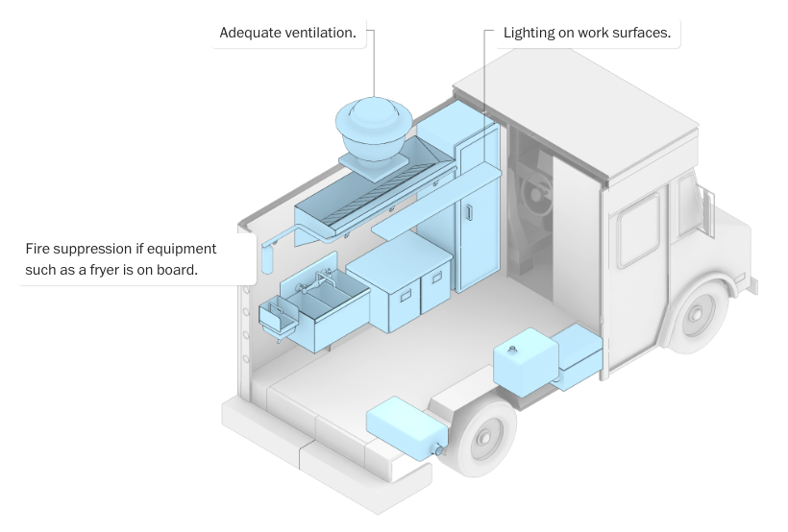
We’ve also made graphics on:
Food trucks
What’s in a food truck?
https://wapo.st/foodtrucks

Slide 16
We’ve also made graphics on:
Wildfires
The grim scope of 2017’s California wildfire season is now clear. The danger’s not over.
http://wapo.st/california-fires-2017

Slide 17
Basically, we do stories on everything.
Breaking news
Education
Politics
Space
Autonomous cars
Local
Foreign
And so on and so forth...

Slide 18
Why are visuals teams so important?
Our work...
Provides new experiences for readers
Uses data and statistics to make points stronger
Can enhance stories and make them more enticing
Can make stories easier to understand
Encourages cross-platform collaboration

Slide 19
With that, let’s get started.
HTML basics

